Slide 1
Churn Analysis Project
Demonstrating the Value of Churn Analysis to Business Stakeholders

Slide 2
Introduction
The goal of this project is to analyze customer churn and identify factors influencing customer retention.
Understanding customer churn is crucial for improving customer retention strategies and maintaining business profitability.

Slide 3
Data Overview
The dataset contains information on customer demographics, behavior, and churn status.
Some columns are as follows: Credit Score, Age, Tenure, Estimated Salary and the target column ‘Exited’. This will be the target column in the modelling.
Connect to stakeholder needs: By analyzing this data, we can uncover patterns and insights to reduce customer churn and enhance customer satisfaction.

Slide 4
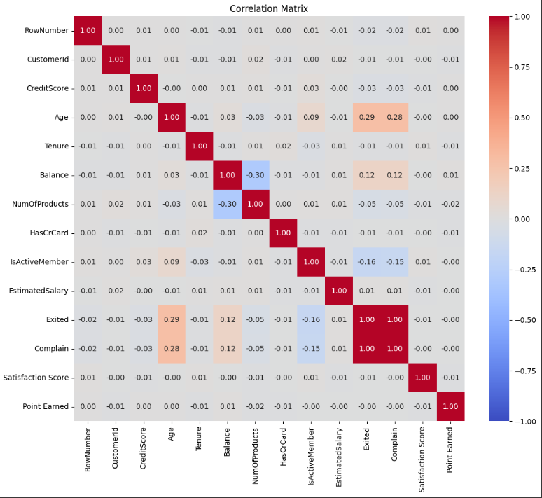
Correlation between fields

Slide 5
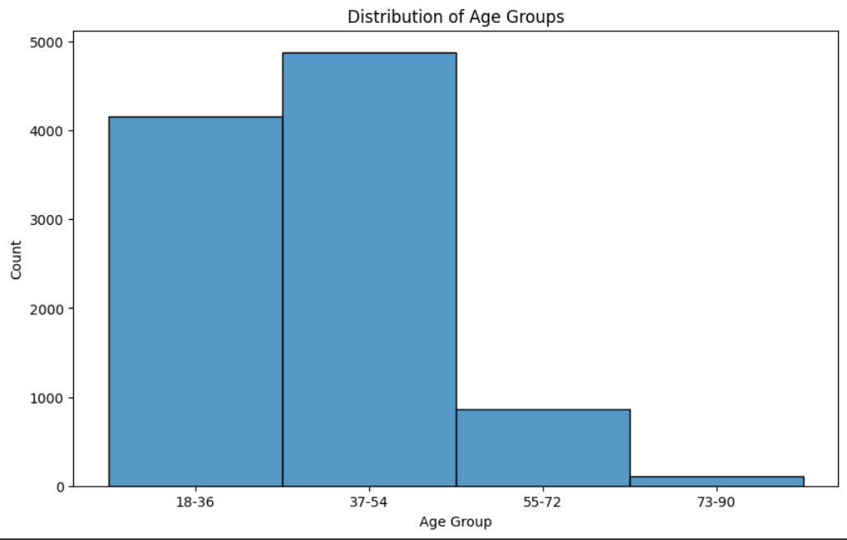
Exploratory Data Analysis
Univariate analysis
This shows the distribution of
Customers by age groups

Slide 6
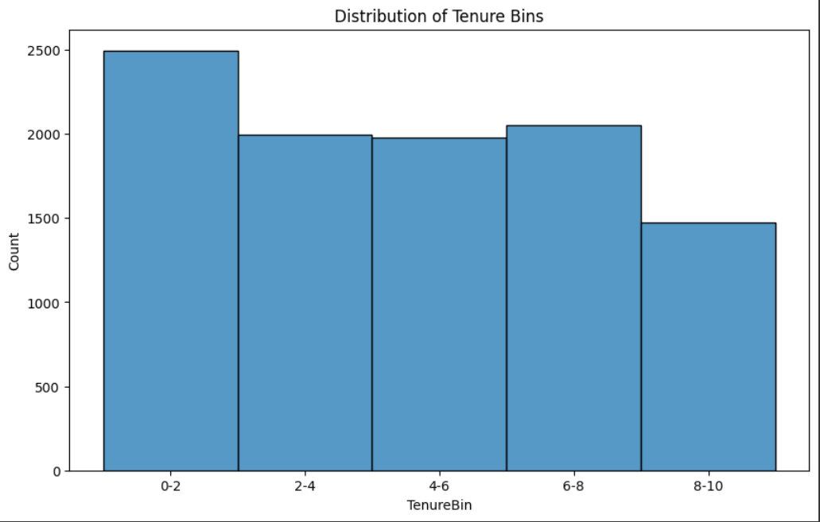
Exploratory Data Analysis
Univariate Data Analysis
Showing the distribution of
Customers by tenure groups.

Slide 7
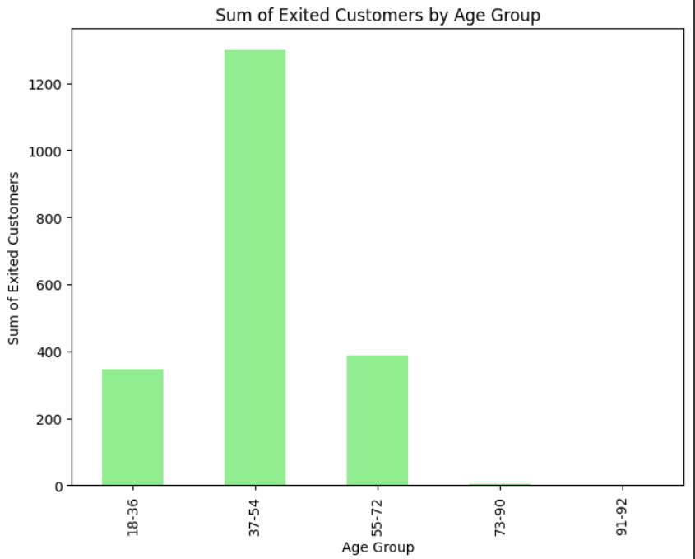
Exploratory Data Analysis
Bivariate Analysis
Showing number of customers
who have exited by age group

Slide 8
Modelling
- Identify High-Risk Customers: Utilize the Decision Tree model to pinpoint customers at high risk of churn based on key predictive features.
- Tailored Retention Strategies: Develop targeted retention strategies tailored to address specific factors identified by the Decision Tree as influential in customer churn.
- Proactive Engagement: Implement proactive engagement initiatives for customers identified as high-risk, such as personalized offers or loyalty programs, to mitigate churn.
- Customer Segmentation: Leverage insights from the Decision Tree to segment customers based on churn propensity, allowing for more customized marketing and service approaches.
- Continuous Monitoring: Regularly monitor the performance of the Decision Tree model and update retention strategies accordingly to adapt to changing customer behaviors.
- Feedback Loop: Establish a feedback loop to gather insights from customer interactions and model predictions, enabling continuous improvement of retention efforts.

Slide 9
Conclusion
In summary, our analysis using the Decision Tree model has given us important insights into why customers leave. By using these insights to create personalized strategies, we hope to keep more customers happy and loyal. We'll keep an eye on things and adjust our approach as needed to ensure our business continues to thrive.

